Slide 1
Welcome to Honors Visual Art!
Spring 2021

Slide 2
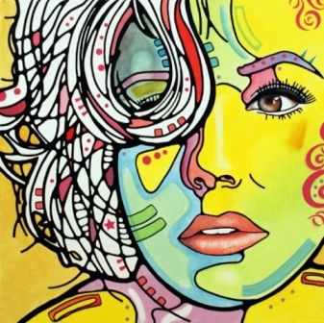
Basic Information:
Mrs. P. Hansen phansen@wcpss.net
Canvas, Visual Art Adv. Proficient Honors (3, 4) P. Hansen
SMART Lunch: Tues/Th, Wed- NAHS
National Art Honor Society(Art Club) Wed. A

Slide 3
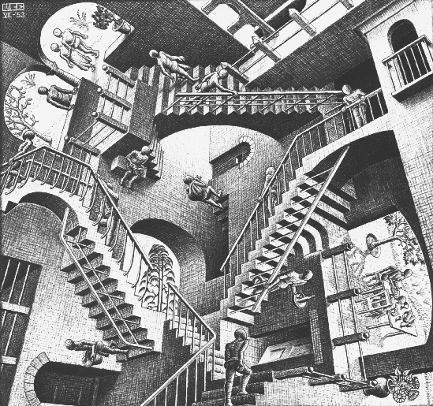
Basic Expectations:
Arrive to class on time, ready to go! Tardy at the bell. Drawing first 10 minutes…
BYOD allowed unless not part of what we are doing. Turn off and put away.
No eating/drinking except water bottles.
Dress code: use common sense. No hats, pj’s, skimpy
Keep up with deadlines, daily work.
Do your own work!

Slide 4
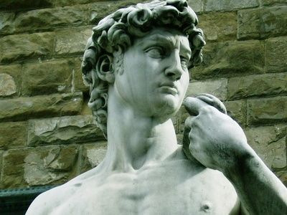
Grading Breakdown:
Major Assessments: 60%
Minor Assessments: 40%
Honors level has individualized calendar/checklist of skills
Honors Portfolio: Major Assessment

Slide 5
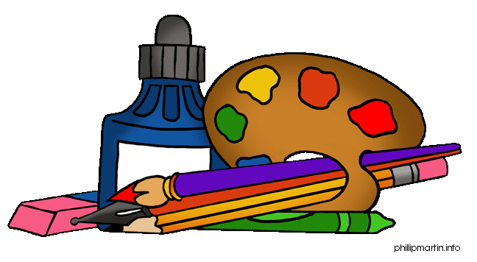
Visual Art Honors supplies:
Supply list: Should be in the room by 1/28, Monday
Colored pencils- blendable plexiglass
Drawing Pencils-6h-6B Paint Brush set (small)
Erasers-variety Fine tip Sharpie, colors
Pastel pencils/soft/variety White Charcoal pencil
Acrylic paints- set/medium x-acto knife
Sketch book- 9 x 12 muslin or silk/ silk painting
Watercolor set (small tubes) Camera- printable
Oil pastels wood stips/make your own canvas
Box cutter paint shirt or apron

Slide 6
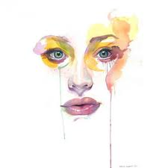
Visual Art Honors does a lot:
Drawing skills: line, shape, value, perspective, proportions: Basic Building block
Elements and Principles of Design: applied.
Painting: color theory, watercolor, silk, acrylic, we will construct our own
Photography: photomontages /themes
Printing: plexiglass etching
Scratch board: using figure, contrast and details
Multi-media
Careers Research
Art History and Current trends in Art- presentations
Art Museum trip….

Slide 7
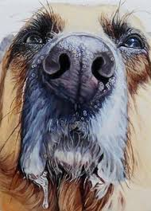
Honors Themes
Choosing good themes/concentrations are key to success!
Contemporary Art installations/murals will be part of our semester.

Slide 8
Visual Art Honors Pacing guide
Turned in weekly: Sketchbook
Visual Art Advanced Proficient (4H): Portfolio with 20 artworks
Themes and concentrations key to success.
Many advanced medias: we will construct our own canvases, produce plexiglass etchings, and create a silk batik fabric painting, etc…

Slide 9
Getting to know you…
Parent letter/ Supply list/ Art survey.
Pacing guide of projects/concepts: weekly sketchbook
Choose one of the concentrations from list: __________________
Draw three variations of your theme, No. 1 due Friday 1/29, 2-3 due 2/5.
Using a minimum of two medias each drawing.
Each drawing should be on a separate sheet.

