Slide 1
Welcome to Visual Art Beginning
Spring 2021
Mrs. Hansen
1611

Slide 2
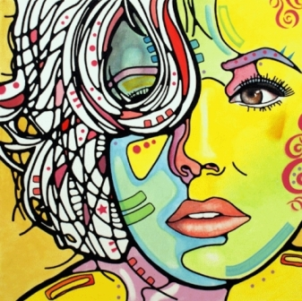
Basic Information:
Mrs. P. Hansen phansen@wcpss.net
Canvas, Visual Art 1(Beg.) P. Hansen
SMART Lunch:M-F :Wed- NAHS
National Art Honor Society(Art Club) Wed. A
Weebly site: https://pcnahs.weebly.com

Slide 3
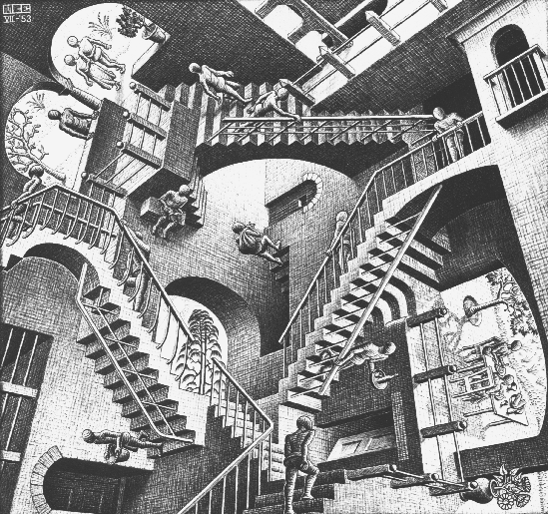
Basic Expectations:
Arrive to class on time, ready to go! Tardy at the bell. Daily meets
BYOD allowed unless not part of what we are doing. Turn off and put away.
No eating/drinking except water bottles.
Dress code: use common sense. No hats, pj’s, skimpy
Keep up with deadlines, daily work.
Do your own work!

Slide 4
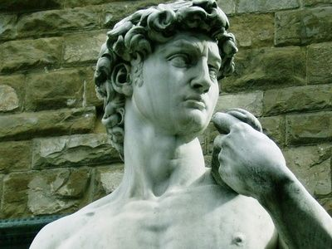
Grading Breakdown:
Major Assessments: 60%
Minor Assessments: 40%
Weekly Assignments on Canvas
Sketchbooks due on Fri.
Projects have deadlines.
Personal Improvement and
Effort factor into this.

Slide 5
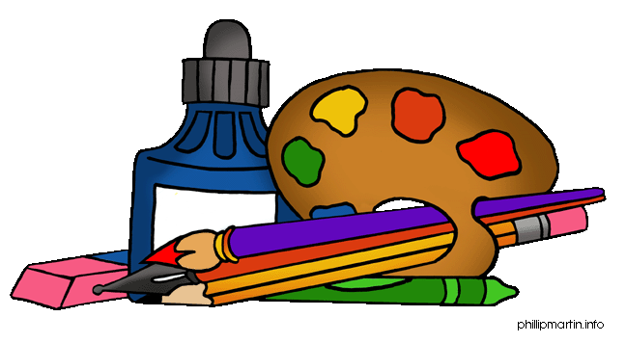
Art supplies
Even more important this year!
Supply list: Should be available by 1/25, Monday
Colored pencils- blendable
Drawing Pencils-6h-6B Paint Brush set (small)
Erasers-variety Fine tip Sharpie, colors
Pastel pencils/soft/variety White Charcoal pencil
Acrylic paints- black and white x-acto knife
Sketch book- 9 x 12 unlined composition book
Watercolor set (small tubes) Camera- printable
Oil pastels Crayons paint shirt or apron

Slide 6
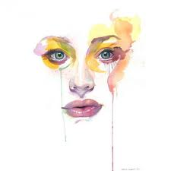
Art 1(Beg.) does a lot:
Drawing skills: line, shape, value, perspective, proportions: Basic Building block
Elements and Principles of Design: applied.
Painting: color theory, watercolor, acrylic, card/brush
Photography: photomontages
Printing: card, stamp, linoleum
Scratch board: using figure, contrast and details
3-D:clay and cardboard
Careers Research
Art History and Current trends in Art- presentations
Art Museum trip….

Slide 7
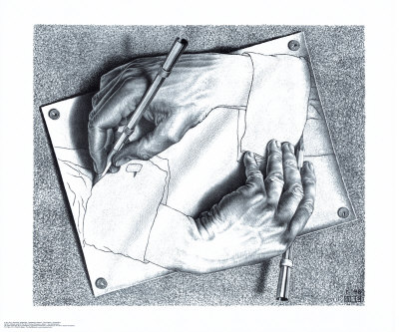
Art 1(Beg.) Sketchbooks
More than assignments: idea pages
Should be on unlined paper/ 1-2 hrs.
First assignment- Due Friday, 1/22
Illustrate this quote:
Must include yourself in it….
“A picture is worth a thousand words.”
Napoleon Bonaparte

Slide 8
Getting to know you…
Art survey:TC color survey.
Draw the following objects:
A Hand/yours
A Face/selfie
A Body/selfie
A Chair/from real life
Each drawing should be on a separate sheet.

